Slide 1
WELCOME

Slide 2
WELCOME

Slide 3
WELCOME

Slide 4
Text-Based Adventure
C Programming Odyssey
Embark on a journey through code. Discover the creation of a text-based adventure game. Explore the methodology, challenges, and future of this C programming project.

Slide 5
Shadows of the forsaken

Slide 6
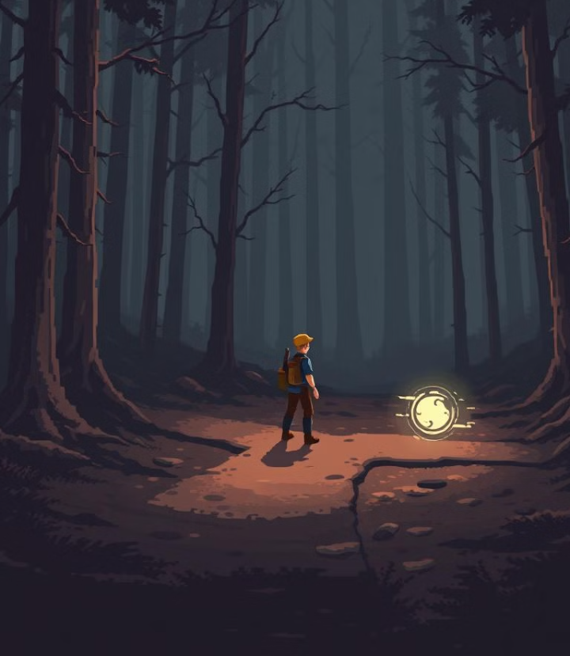
Shadows of the forsaken
INTERACTIVE NARATIVE
Engage in a branching storyline.
Make choices that shape your adventure.
C PROGRAMMING CORE
Built entirely in C. Optimized for performance and resource management.

Slide 7
Shadows of the forsaken
INTERACTIVE NARATIVE
Engage in a branching storyline.
Make choices that shape your adventure.
C PROGRAMMING CORE
Built entirely in C. Optimized for performance and resource management.
RETRO AESTHETICS
Classic text-based interface. Evokes nostalgia for early computer games

Slide 8
Immersive Story
Player Agency
Your decisions matter. Multiple endings based on your choices.
Shadows of the forsaken
C PROGRAMMING CORE
Built entirely in C. Optimized for performance and resource management.
RETRO AESTHETICS
Classic text-based interface. Evokes nostalgia for early computer games
IMMERSIVE STORY
A rich, detailed world. Uncover secrets and face challenging quests.

Slide 9
Immersive Story
Player Agency
Your decisions matter. Multiple endings based on your choices.
Shadows of the forsaken
C PROGRAMMING CORE
Built entirely in C. Optimized for performance and resource management.
IMMERSIVE STORY
A rich, detailed world. Uncover secrets and face challenging quests.
PLAYER AGENCY
Your decisions matter. Multiple endings based on your choices.
RETRO AESTHETICS
Classic text-based interface. Evokes nostalgia for early computer games

Slide 10
Immersive Story
Player Agency
Your decisions matter. Multiple endings based on your choices.
Shadows of the forsaken
C PROGRAMMING CORE
Built entirely in C. Optimized for performance and resource management.
IMMERSIVE STORY
A rich, detailed world. Uncover secrets and face challenging quests.
PLAYER AGENCY
Your decisions matter. Multiple endings based on your choices.
RETRO AESTHETICS
Classic text-based interface. Evokes nostalgia for early computer games

Slide 11




FROM CONCPET TO CODE
IDEA
DESIGN
DEBUGGING
CODE

Slide 12
TEAM
WELCOME
CRYPTIC CODEX

Slide 13







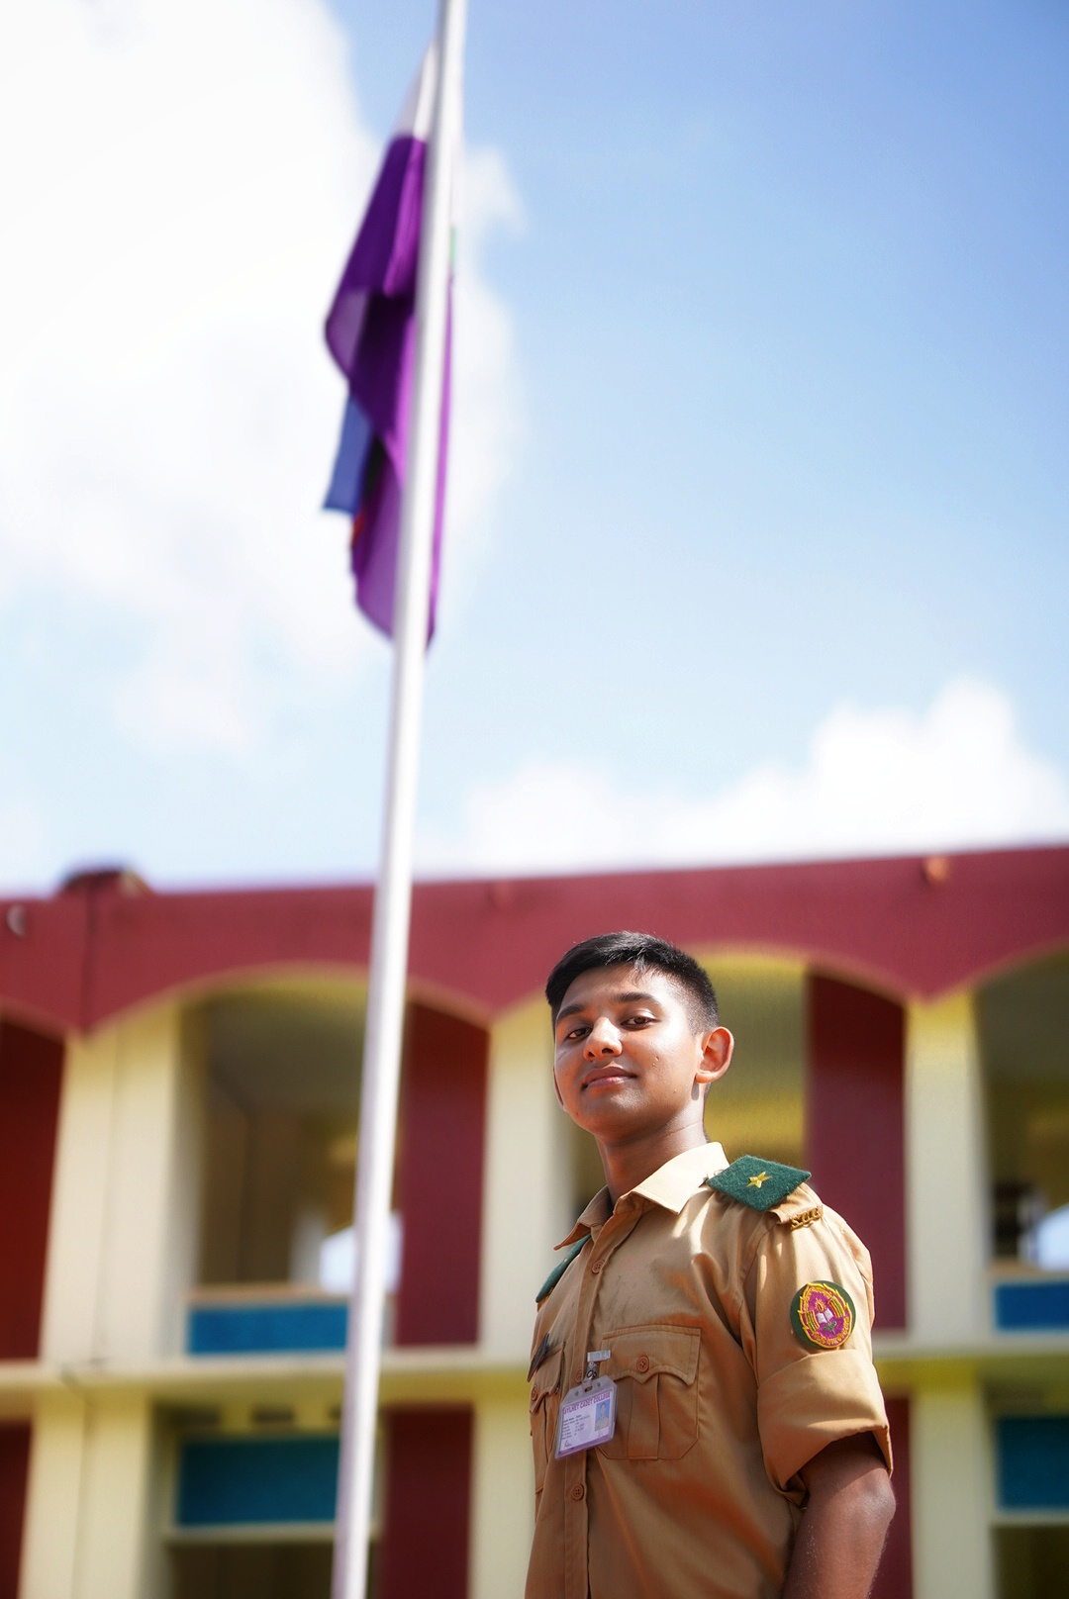




CRYPTIC CODEX
Siam
Sunnah
Arin
Shayikh
Fahim
sterben.86
MD. FAHIM HOSSAIN
I am a passionate problem solver with a penchant for creative thinking. As a learner, I pursue innovation, fostering collaboration as well as mentoring and inspiring my fellow peers.
sidratul.audhira.251@northsouth.edu
Fahim Hossain Siam

Slide 14




CRYPTIC CODEX
Fahim
Sunnah
Arin
Shayikh
Siam
siam_672
ANIK RAHMAN SIAM
TEAM CO-ORDINATOR
Specializing in problem-solving and computer science, I design impactful educational experiences. My scouting background reinforces me in leadership, discipline, and mentoring capabilities.
siam-rahman-85074420b
Siam

Slide 15


CRYPTIC CODEX
Fahim
Siam
Arin
Shayikh
Sunnah
sunnah_75
TANVIR SUNNAH
tanvir-sunnah-594235314
Tanvir Sunnah

Slide 16


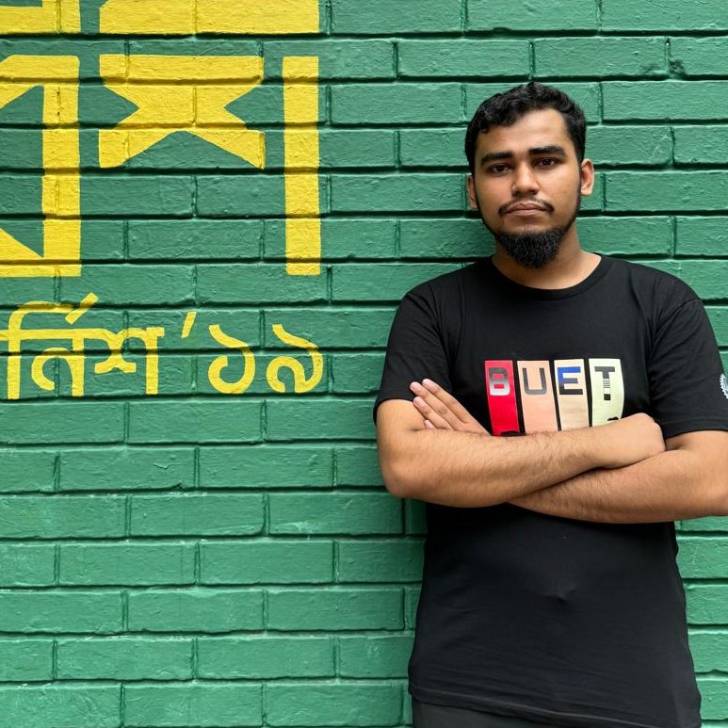
CRYPTIC CODEX
Fahim
Siam
Sunnah
Shayikh
Arin
e_r_i_k251221
AL ARIK
TEAM CO-ORDINATOR
Driven by curiosity and a passion for physics, I love experimentation and innovative problem-solving. I am committed to advancing the field while inspiring others through collaboration and inventive solutions.
aaa-alif-827256326
AL Arik (Arin)

Slide 17



CRYPTIC CODEX
Fahim
Siam
Sunnah
Arin
Shayikh
lucid_rhetoric_313
SHAYIKH MOSTOFA
TEAM CO-ORDINATOR
With an undying passion for always learning something new, Problem-solving has been a never-ending adventure for me. I hope to see and meet fellow adventurers to integrate this amazing domain with Physics!
md-shayikh-mostofa-9b44b8251
Shayikh Mostofa

Slide 18

DISCOVER
SHADOWS OF THE FORSAKEN

Slide 19
DISCOVER
SHADOWS OF THE FORSAKEN

Slide 20
DISCOVER
SHADOWS OF THE FORSAKEN

Slide 21
VISIONS & VALUES
To enable students from all countries to prove their math skills and to unleash their creativity

Slide 22
FROM HELLO WORLD
TO ADVENTURE

Slide 23
FROM HELLO WORLD
TO ADVENTURE
#include <stdio.h>
int main() {
int choice;
printf("Welcome to the Dark Forest!\n");
printf("You are standing at a crossroads.\n");
printf("Press 1 to go left or 2 to go right: ");
scanf("%d", &choice);
if (choice == 1) {
printf("You walk into a deep fog and suddenly fall into a hidden pit. Game Over!\n");
} else if (choice == 2) {
printf("You find a treasure chest filled with gold. You Win!\n");
} else {
printf("You stand there, unable to decide, and a wild beast finds you. Game Over!\n");
}
return 0;
}
Online Submission:
The competition uses the possibilities of the modern internet to give all students the opportunity to participate regardless of nation, region, or school.

Slide 24
FROM HELLO WORLD
TO ADVENTURE
#include <stdio.h>
int main() {
int choice;
printf("Welcome to the Dark Forest!\n");
printf("You are standing at a crossroads.\n");
printf("Press 1 to go left or 2 to go right: ");
scanf("%d", &choice);
if (choice == 1) {
printf("You walk into a deep fog and suddenly fall into a hidden pit. Game Over!\n");
} else if (choice == 2) {
printf("You find a treasure chest filled with gold. You Win!\n");
} else {
printf("You stand there, unable to decide, and a wild beast finds you. Game Over!\n");
}
return 0;
}
Online Submission:
The competition uses the possibilities of the modern internet to give all students the opportunity to participate regardless of nation, region, or school.

Slide 25
FROM HELLO WORLD
TO ADVENTURE
#include <stdio.h>
int main() {
int choice;
printf("Welcome to the Dark Forest!\n");
printf("You are standing at a crossroads.\n");
printf("Press 1 to go left or 2 to go right: ");
scanf("%d", &choice);
if (choice == 1) {
printf("You walk into a deep fog and suddenly fall into a hidden pit. Game Over!\n");
} else if (choice == 2) {
printf("You find a treasure chest filled with gold. You Win!\n");
} else {
printf("You stand there, unable to decide, and a wild beast finds you. Game Over!\n");
}
return 0;
}
#include <stdio.h>
int main() {
int choice;
while (1) {
printf("Welcome to the Dark Forest!\n");
printf("You are standing at a crossroads.\n");
printf("Press 1 to go left, 2 to go right, or 3 to exit: ");
scanf("%d", &choice);
if (choice == 1) {
printf("You walk into a deep fog and suddenly fall into a hidden pit. Game Over!\n");
}
else if (choice == 2) {
printf("You find a treasure chest filled with gold. You Win!\n");
} else if (choice == 3) {
printf("Exiting the game...\n");
break;
} else {
printf("Invalid choice. Try again.\n");
}
}
return 0;
}

Slide 26
FROM HELLO WORLD
TO ADVENTURE
#include <stdio.h>
int main() {
int choice;
printf("Welcome to the Dark Forest!\n");
printf("You are standing at a crossroads.\n");
printf("Press 1 to go left or 2 to go right: ");
scanf("%d", &choice);
if (choice == 1) {
printf("You walk into a deep fog and suddenly fall into a hidden pit. Game Over!\n");
} else if (choice == 2) {
printf("You find a treasure chest filled with gold. You Win!\n");
} else {
printf("You stand there, unable to decide, and a wild beast finds you. Game Over!\n");
}
return 0;
}
#include <stdio.h>
int main() {
int choice;
while (1) {
printf("Welcome to the Dark Forest!\n");
printf("You are standing at a crossroads.\n");
printf("Press 1 to go left, 2 to go right, or 3 to exit: ");
scanf("%d", &choice);
if (choice == 1) {
printf("You walk into a deep fog and suddenly fall into a hidden pit. Game Over!\n");
}
else if (choice == 2) {
printf("You find a treasure chest filled with gold. You Win!\n");
} else if (choice == 3) {
printf("Exiting the game...\n");
break;
} else {
printf("Invalid choice. Try again.\n");
}
}
return 0;
}

Slide 27
#include <stdio.h>
int main() {
int choice;
while (1) {
printf("Welcome to the Dark Forest!\n");
printf("You are standing at a crossroads.\n");
printf("Press 1 to go left, 2 to go right, or 3 to exit: ");
scanf("%d", &choice);
if (choice == 1) {
printf("You walk into a deep fog and suddenly fall into a hidden pit. Game Over!\n");
}
else if (choice == 2) {
printf("You find a treasure chest filled with gold. You Win!\n");
} else if (choice == 3) {
printf("Exiting the game...\n");
break;
} else {
printf("Invalid choice. Try again.\n");
}
}
return 0;
}
FROM HELLO WORLD
TO ADVENTURE
#include <stdio.h>
int main() {
int choice;
printf("Welcome to the Dark Forest!\n");
printf("You are standing at a crossroads.\n");
printf("Press 1 to go left or 2 to go right: ");
scanf("%d", &choice);
if (choice == 1) {
printf("You walk into a deep fog and suddenly fall into a hidden pit. Game Over!\n");
} else if (choice == 2) {
printf("You find a treasure chest filled with gold. You Win!\n");
} else {
printf("You stand there, unable to decide, and a wild beast finds you. Game Over!\n");
}
return 0;
}

Slide 28
#include<stdio.h>
void credits() {
int dummy;
printf("\n\tCREDITS\t\n");
printf("\n2512847642\tMd. Fahim Hossain\n");
printf("2511026642\tSamia Zaman\n");
printf("2512244042\tRiazul Jannat\n");
printf("2513009642\tSidratul Muntahara Audhira\n");
printf("\nEnter any number to return to the main menu...\n");
scanf("%d", &dummy);
main();
}
void new_game(){
int choice;
printf("Some friends will go through an abandoned house which is known to be cursed.\n");
printf("So they are curious to know is it baseless or true.\n");
printf("Somehow they will end up being there and they will be trapped.\n");
printf("What will you do?\n");
printf("1. Explore Ground Floor.\n");
printf("2. Explore 1st Floor.\n");
scanf(“%d”,&choice);
}
int main(void){
int choice, exit_choice;
printf("Welcome to {Game Name}");
printf("\n1. NEW GAME\n2. CREDITS\n3. EXIT\n");
scanf("%d", &choice);
if (choice == 1)
new_game();
else if (choice == 2)
credits();
else if (choice == 3) {
printf("\nAre you sure you want to exit?");
printf("\n 1. Yes :( 2. No :D");
scanf("%d", &exit_choice);
if (exit_choice == 1)
printf("Exiting the Game.....\n");
else if (exit_choice == 2)
printf("\n");
main();
}
}
return 0;
}
#include <stdio.h>
int main() {
int choice;
while (1) {
printf("Welcome to the Dark Forest!\n");
printf("You are standing at a crossroads.\n");
printf("Press 1 to go left, 2 to go right, or 3 to exit: ");
scanf("%d", &choice);
if (choice == 1) {
printf("You walk into a deep fog and suddenly fall into a hidden pit. Game Over!\n");
}
else if (choice == 2) {
printf("You find a treasure chest filled with gold. You Win!\n");
} else if (choice == 3) {
printf("Exiting the game...\n");
break;
} else {
printf("Invalid choice. Try again.\n");
}
}
return 0;
}
FROM HELLO WORLD
TO ADVENTURE
#include <stdio.h>
int main() {
int choice;
printf("Welcome to the Dark Forest!\n");
printf("You are standing at a crossroads.\n");
printf("Press 1 to go left or 2 to go right: ");
scanf("%d", &choice);
if (choice == 1) {
printf("You walk into a deep fog and suddenly fall into a hidden pit. Game Over!\n");
} else if (choice == 2) {
printf("You find a treasure chest filled with gold. You Win!\n");
} else {
printf("You stand there, unable to decide, and a wild beast finds you. Game Over!\n");
}
return 0;
}

Slide 29
#include<stdio.h>
void credits() {
int dummy;
printf("\n\tCREDITS\t\n");
printf("\n2512847642\tMd. Fahim Hossain\n");
printf("2511026642\tSamia Zaman\n");
printf("2512244042\tRiazul Jannat\n");
printf("2513009642\tSidratul Muntahara Audhira\n");
printf("\nEnter any number to return to the main menu...\n");
scanf("%d", &dummy);
main();
}
void new_game(){
int choice;
printf("Some friends will go through an abandoned house which is known to be cursed.\n");
printf("So they are curious to know is it baseless or true.\n");
printf("Somehow they will end up being there and they will be trapped.\n");
printf("What will you do?\n");
printf("1. Explore Ground Floor.\n");
printf("2. Explore 1st Floor.\n");
scanf(“%d”,&choice);
}
int main(void){
int choice, exit_choice;
printf("Welcome to {Game Name}");
printf("\n1. NEW GAME\n2. CREDITS\n3. EXIT\n");
scanf("%d", &choice);
if (choice == 1)
new_game();
else if (choice == 2)
credits();
else if (choice == 3) {
printf("\nAre you sure you want to exit?");
printf("\n 1. Yes :( 2. No :D");
scanf("%d", &exit_choice);
if (exit_choice == 1)
printf("Exiting the Game.....\n");
else if (exit_choice == 2)
printf("\n");
main();
}
}
return 0;
}
#include <stdio.h>
int main() {
int choice;
while (1) {
printf("Welcome to the Dark Forest!\n");
printf("You are standing at a crossroads.\n");
printf("Press 1 to go left, 2 to go right, or 3 to exit: ");
scanf("%d", &choice);
if (choice == 1) {
printf("You walk into a deep fog and suddenly fall into a hidden pit. Game Over!\n");
}
else if (choice == 2) {
printf("You find a treasure chest filled with gold. You Win!\n");
} else if (choice == 3) {
printf("Exiting the game...\n");
break;
} else {
printf("Invalid choice. Try again.\n");
}
}
return 0;
}
FROM HELLO WORLD
TO ADVENTURE
#include <stdio.h>
int main() {
int choice;
printf("Welcome to the Dark Forest!\n");
printf("You are standing at a crossroads.\n");
printf("Press 1 to go left or 2 to go right: ");
scanf("%d", &choice);
if (choice == 1) {
printf("You walk into a deep fog and suddenly fall into a hidden pit. Game Over!\n");
} else if (choice == 2) {
printf("You find a treasure chest filled with gold. You Win!\n");
} else {
printf("You stand there, unable to decide, and a wild beast finds you. Game Over!\n");
}
return 0;
}

Slide 30
#include<stdio.h>
void credits() {
int dummy;
printf("\n\tCREDITS\t\n");
printf("\n2512847642\tMd. Fahim Hossain\n");
printf("2511026642\tSamia Zaman\n");
printf("2512244042\tRiazul Jannat\n");
printf("2513009642\tSidratul Muntahara Audhira\n");
printf("\nEnter any number to return to the main menu...\n");
scanf("%d", &dummy);
main();
}
void new_game(){
int choice;
printf("Some friends will go through an abandoned house which is known to be cursed.\n");
printf("So they are curious to know is it baseless or true.\n");
printf("Somehow they will end up being there and they will be trapped.\n");
printf("What will you do?\n");
printf("1. Explore Ground Floor.\n");
printf("2. Explore 1st Floor.\n");
scanf(“%d”,&choice);
}
int main(void){
int choice, exit_choice;
printf("Welcome to {Game Name}");
printf("\n1. NEW GAME\n2. CREDITS\n3. EXIT\n");
scanf("%d", &choice);
if (choice == 1)
new_game();
else if (choice == 2)
credits();
else if (choice == 3) {
printf("\nAre you sure you want to exit?");
printf("\n 1. Yes :( 2. No :D");
scanf("%d", &exit_choice);
if (exit_choice == 1)
printf("Exiting the Game.....\n");
else if (exit_choice == 2)
printf("\n");
main();
}
}
return 0;
}
#include <stdio.h>
int main() {
int choice;
while (1) {
printf("Welcome to the Dark Forest!\n");
printf("You are standing at a crossroads.\n");
printf("Press 1 to go left, 2 to go right, or 3 to exit: ");
scanf("%d", &choice);
if (choice == 1) {
printf("You walk into a deep fog and suddenly fall into a hidden pit. Game Over!\n");
}
else if (choice == 2) {
printf("You find a treasure chest filled with gold. You Win!\n");
} else if (choice == 3) {
printf("Exiting the game...\n");
break;
} else {
printf("Invalid choice. Try again.\n");
}
}
return 0;
}
FROM HELLO WORLD
TO ADVENTURE
#include <stdio.h>
int main() {
int choice;
printf("Welcome to the Dark Forest!\n");
printf("You are standing at a crossroads.\n");
printf("Press 1 to go left or 2 to go right: ");
scanf("%d", &choice);
if (choice == 1) {
printf("You walk into a deep fog and suddenly fall into a hidden pit. Game Over!\n");
} else if (choice == 2) {
printf("You find a treasure chest filled with gold. You Win!\n");
} else {
printf("You stand there, unable to decide, and a wild beast finds you. Game Over!\n");
}
return 0;
}

Slide 31
#include <stdio.h>
int main() {
int choice;
while (1) {
printf("Welcome to the Dark Forest!\n");
printf("You are standing at a crossroads.\n");
printf("Press 1 to go left, 2 to go right, or 3 to exit: ");
scanf("%d", &choice);
if (choice == 1) {
printf("You walk into a deep fog and suddenly fall into a hidden pit. Game Over!\n");
}
else if (choice == 2) {
printf("You find a treasure chest filled with gold. You Win!\n");
} else if (choice == 3) {
printf("Exiting the game...\n");
break;
} else {
printf("Invalid choice. Try again.\n");
}
}
return 0;
}
#include<stdio.h>
void credits() {
int dummy;
printf("\n\tCREDITS\t\n");
printf("\n2512847642\tMd. Fahim Hossain\n");
printf("2511026642\tSamia Zaman\n");
printf("2512244042\tRiazul Jannat\n");
printf("2513009642\tSidratul Muntahara Audhira\n");
printf("\nEnter any number to return to the main menu...\n");
scanf("%d", &dummy);
main();
}
void new_game(){
int choice;
printf("Some friends will go through an abandoned house which is known to be cursed.\n");
printf("So they are curious to know is it baseless or true.\n");
printf("Somehow they will end up being there and they will be trapped.\n");
printf("What will you do?\n");
printf("1. Explore Ground Floor.\n");
printf("2. Explore 1st Floor.\n");
scanf(“%d”,&choice);
}
int main(void){
int choice, exit_choice;
printf("Welcome to {Game Name}");
printf("\n1. NEW GAME\n2. CREDITS\n3. EXIT\n");
scanf("%d", &choice);
if (choice == 1)
new_game();
else if (choice == 2)
credits();
else if (choice == 3) {
printf("\nAre you sure you want to exit?");
printf("\n 1. Yes :( 2. No :D");
scanf("%d", &exit_choice);
if (exit_choice == 1)
printf("Exiting the Game.....\n");
else if (exit_choice == 2)
printf("\n");
main();
}
}
return 0;
}
FROM HELLO WORLD
TO ADVENTURE
#include <stdio.h>
int main() {
int choice;
printf("Welcome to the Dark Forest!\n");
printf("You are standing at a crossroads.\n");
printf("Press 1 to go left or 2 to go right: ");
scanf("%d", &choice);
if (choice == 1) {
printf("You walk into a deep fog and suddenly fall into a hidden pit. Game Over!\n");
} else if (choice == 2) {
printf("You find a treasure chest filled with gold. You Win!\n");
} else {
printf("You stand there, unable to decide, and a wild beast finds you. Game Over!\n");
}
return 0;
}

Slide 32
#include <stdio.h>
int main() {
int choice;
while (1) {
printf("Welcome to the Dark Forest!\n");
printf("You are standing at a crossroads.\n");
printf("Press 1 to go left, 2 to go right, or 3 to exit: ");
scanf("%d", &choice);
if (choice == 1) {
printf("You walk into a deep fog and suddenly fall into a hidden pit. Game Over!\n");
}
else if (choice == 2) {
printf("You find a treasure chest filled with gold. You Win!\n");
} else if (choice == 3) {
printf("Exiting the game...\n");
break;
} else {
printf("Invalid choice. Try again.\n");
}
}
return 0;
}
FROM HELLO WORLD
TO ADVENTURE
#include<stdio.h>
void credits() {
int dummy;
printf("\n\tCREDITS\t\n");
printf("\n2512847642\tMd. Fahim Hossain\n");
printf("2511026642\tSamia Zaman\n");
printf("2512244042\tRiazul Jannat\n");
printf("2513009642\tSidratul Muntahara Audhira\n");
printf("\nEnter any number to return to the main menu...\n");
scanf("%d", &dummy);
main();
}
void new_game(){
int choice;
printf("Some friends will go through an abandoned house which is known to be cursed.\n");
printf("So they are curious to know is it baseless or true.\n");
printf("Somehow they will end up being there and they will be trapped.\n");
printf("What will you do?\n");
printf("1. Explore Ground Floor.\n");
printf("2. Explore 1st Floor.\n");
scanf(“%d”,&choice);
}
int main(void){
int choice, exit_choice;
printf("Welcome to {Game Name}");
printf("\n1. NEW GAME\n2. CREDITS\n3. EXIT\n");
scanf("%d", &choice);
if (choice == 1)
new_game();
else if (choice == 2)
credits();
else if (choice == 3) {
printf("\nAre you sure you want to exit?");
printf("\n 1. Yes :( 2. No :D");
scanf("%d", &exit_choice);
if (exit_choice == 1)
printf("Exiting the Game.....\n");
else if (exit_choice == 2)
printf("\n");
main();
}
}
return 0;
}

Slide 33
#include <stdio.h>
int main() {
int choice;
while (1) {
printf("Welcome to the Dark Forest!\n");
printf("You are standing at a crossroads.\n");
printf("Press 1 to go left, 2 to go right, or 3 to exit: ");
scanf("%d", &choice);
if (choice == 1) {
printf("You walk into a deep fog and suddenly fall into a hidden pit. Game Over!\n");
}
else if (choice == 2) {
printf("You find a treasure chest filled with gold. You Win!\n");
} else if (choice == 3) {
printf("Exiting the game...\n");
break;
} else {
printf("Invalid choice. Try again.\n");
}
}
return 0;
}
FROM HELLO WORLD
TO ADVENTURE
#include<stdio.h>
void credits() {
int dummy;
printf("\n\tCREDITS\t\n");
printf("\n2512847642\tMd. Fahim Hossain\n");
printf("2511026642\tSamia Zaman\n");
printf("2512244042\tRiazul Jannat\n");
printf("2513009642\tSidratul Muntahara Audhira\n");
printf("\nEnter any number to return to the main menu...\n");
scanf("%d", &dummy);
main();
}
void new_game(){
int choice;
printf("Some friends will go through an abandoned house which is known to be cursed.\n");
printf("So they are curious to know is it baseless or true.\n");
printf("Somehow they will end up being there and they will be trapped.\n");
printf("What will you do?\n");
printf("1. Explore Ground Floor.\n");
printf("2. Explore 1st Floor.\n");
scanf(“%d”,&choice);
}
int main(void){
int choice, exit_choice;
printf("Welcome to {Game Name}");
printf("\n1. NEW GAME\n2. CREDITS\n3. EXIT\n");
scanf("%d", &choice);
if (choice == 1)
new_game();
else if (choice == 2)
credits();
else if (choice == 3) {
printf("\nAre you sure you want to exit?");
printf("\n 1. Yes :( 2. No :D");
scanf("%d", &exit_choice);
if (exit_choice == 1)
printf("Exiting the Game.....\n");
else if (exit_choice == 2)
printf("\n");
main();
}
}
return 0;
}
#include <stdlib.h>
int get_choice(int num_choices) {
int choice;
printf("\nEnter your choice (1 to %d): ", num_choices);
scanf("%d", &choice);
while (getchar() != '\n'); // Clear input buffer
if (choice >= 1 && choice <= num_choices)
return choice;
else {
printf("Invalid choice. Please try again.\n");
return get_choice(num_choices); }
}
void game_over(){
printf("Game Over.\n");
printf("Press ENTER to return to the main menu...\n");
// ENTER to be back to MAIN MENU
getchar();
while (getchar() != '\n');
main();
}

Slide 34
#include <stdio.h>
int main() {
int choice;
while (1) {
printf("Welcome to the Dark Forest!\n");
printf("You are standing at a crossroads.\n");
printf("Press 1 to go left, 2 to go right, or 3 to exit: ");
scanf("%d", &choice);
if (choice == 1) {
printf("You walk into a deep fog and suddenly fall into a hidden pit. Game Over!\n");
}
else if (choice == 2) {
printf("You find a treasure chest filled with gold. You Win!\n");
} else if (choice == 3) {
printf("Exiting the game...\n");
break;
} else {
printf("Invalid choice. Try again.\n");
}
}
return 0;
}
FROM HELLO WORLD
TO ADVENTURE
#include<stdio.h>
void credits() {
int dummy;
printf("\n\tCREDITS\t\n");
printf("\n2512847642\tMd. Fahim Hossain\n");
printf("2511026642\tSamia Zaman\n");
printf("2512244042\tRiazul Jannat\n");
printf("2513009642\tSidratul Muntahara Audhira\n");
printf("\nEnter any number to return to the main menu...\n");
scanf("%d", &dummy);
main();
}
void new_game(){
int choice;
printf("Some friends will go through an abandoned house which is known to be cursed.\n");
printf("So they are curious to know is it baseless or true.\n");
printf("Somehow they will end up being there and they will be trapped.\n");
printf("What will you do?\n");
printf("1. Explore Ground Floor.\n");
printf("2. Explore 1st Floor.\n");
scanf(“%d”,&choice);
}
int main(void){
int choice, exit_choice;
printf("Welcome to {Game Name}");
printf("\n1. NEW GAME\n2. CREDITS\n3. EXIT\n");
scanf("%d", &choice);
if (choice == 1)
new_game();
else if (choice == 2)
credits();
else if (choice == 3) {
printf("\nAre you sure you want to exit?");
printf("\n 1. Yes :( 2. No :D");
scanf("%d", &exit_choice);
if (exit_choice == 1)
printf("Exiting the Game.....\n");
else if (exit_choice == 2)
printf("\n");
main();
}
}
return 0;
}
#include <stdlib.h>
int get_choice(int num_choices) {
int choice;
printf("\nEnter your choice (1 to %d): ", num_choices);
scanf("%d", &choice);
while (getchar() != '\n'); // Clear input buffer
if (choice >= 1 && choice <= num_choices)
return choice;
else {
printf("Invalid choice. Please try again.\n");
return get_choice(num_choices); }
}
void game_over(){
printf("Game Over.\n");
printf("Press ENTER to return to the main menu...\n");
// ENTER to be back to MAIN MENU
getchar();
while (getchar() != '\n');
main();
}

Slide 35
#include <stdio.h>
int main() {
int choice;
while (1) {
printf("Welcome to the Dark Forest!\n");
printf("You are standing at a crossroads.\n");
printf("Press 1 to go left, 2 to go right, or 3 to exit: ");
scanf("%d", &choice);
if (choice == 1) {
printf("You walk into a deep fog and suddenly fall into a hidden pit. Game Over!\n");
}
else if (choice == 2) {
printf("You find a treasure chest filled with gold. You Win!\n");
} else if (choice == 3) {
printf("Exiting the game...\n");
break;
} else {
printf("Invalid choice. Try again.\n");
}
}
return 0;
}
#include <stdlib.h>
int get_choice(int num_choices) {
int choice;
printf("\nEnter your choice (1 to %d): ", num_choices);
scanf("%d", &choice);
while (getchar() != '\n'); // Clear input buffer
if (choice >= 1 && choice <= num_choices)
return choice;
else {
printf("Invalid choice. Please try again.\n");
return get_choice(num_choices); }
}
void game_over(){
printf("Game Over.\n");
printf("Press ENTER to return to the main menu...\n");
// ENTER to be back to MAIN MENU
getchar();
while (getchar() != '\n');
main();
}
FROM HELLO WORLD
TO ADVENTURE
#include<stdio.h>
void credits() {
int dummy;
printf("\n\tCREDITS\t\n");
printf("\n2512847642\tMd. Fahim Hossain\n");
printf("2511026642\tSamia Zaman\n");
printf("2512244042\tRiazul Jannat\n");
printf("2513009642\tSidratul Muntahara Audhira\n");
printf("\nEnter any number to return to the main menu...\n");
scanf("%d", &dummy);
main();
}
void new_game(){
int choice;
printf("Some friends will go through an abandoned house which is known to be cursed.\n");
printf("So they are curious to know is it baseless or true.\n");
printf("Somehow they will end up being there and they will be trapped.\n");
printf("What will you do?\n");
printf("1. Explore Ground Floor.\n");
printf("2. Explore 1st Floor.\n");
scanf(“%d”,&choice);
}
int main(void){
int choice, exit_choice;
printf("Welcome to {Game Name}");
printf("\n1. NEW GAME\n2. CREDITS\n3. EXIT\n");
scanf("%d", &choice);
if (choice == 1)
new_game();
else if (choice == 2)
credits();
else if (choice == 3) {
printf("\nAre you sure you want to exit?");
printf("\n 1. Yes :( 2. No :D");
scanf("%d", &exit_choice);
if (exit_choice == 1)
printf("Exiting the Game.....\n");
else if (exit_choice == 2)
printf("\n");
main();
}
}
return 0;
}

Slide 36
FROM HELLO WORLD
TO ADVENTURE

Slide 37
PARTICIPANTS

Slide 38


JUNIOR CATEGORY (under 18 years)
To qualify for the pre-final round, students have to solve minimum three problems correctly
PARTICIPANTS

Slide 39
YOUTH CATEGORY (above 18 years)
To qualify for the pre-final round, students have to solve minimum four problems correctly
PARTICIPANTS

Slide 40
PARTICIPANTS

Slide 41
ACHIEVEMENTS & ACCOMPLISHMENTS

Slide 42




ACHIEVEMENTS & ACCOMPLISHMENTS

Slide 43
ACHIEVEMENTS & ACCOMPLISHMENTS

Slide 44
ACHIEVEMENTS & ACCOMPLISHMENTS

Slide 45
ACHIEVEMENTS & ACCOMPLISHMENTS
FOR ALL FINALISTS

Slide 46
ACHIEVEMENTS & ACCOMPLISHMENTS
FOR ALL FINALISTS

Slide 47
ACHIEVEMENTS & ACCOMPLISHMENTS

Slide 48

INTERNATIONAL YOUTH MATH CHALLENGE

Slide 50
WELCOME
INTERNATIONAL YOUTH MATH CHALLENGE

Slide 51
BUT THAT’S
NOT ALL

Slide 52
NATIONAL AWARD
AN HONOUR FOR THE BEST PARTICIPANT FROM OUR COUNTRY

Slide 53
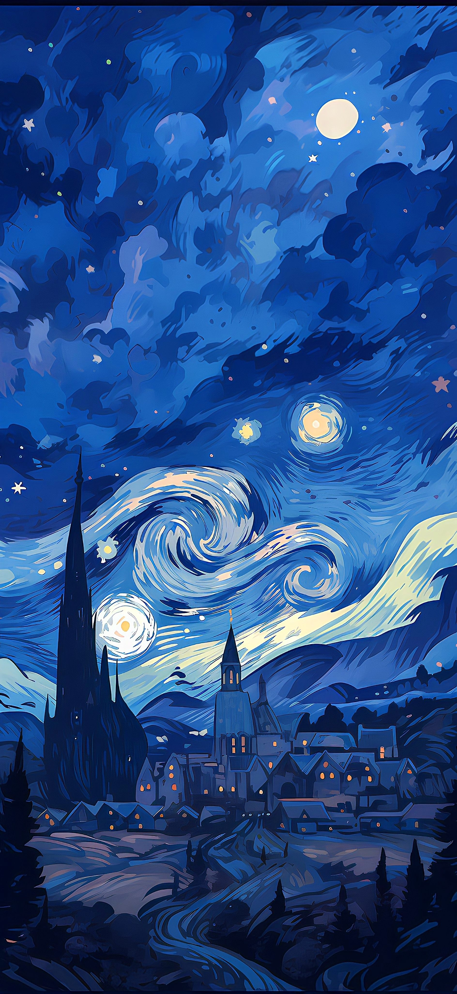
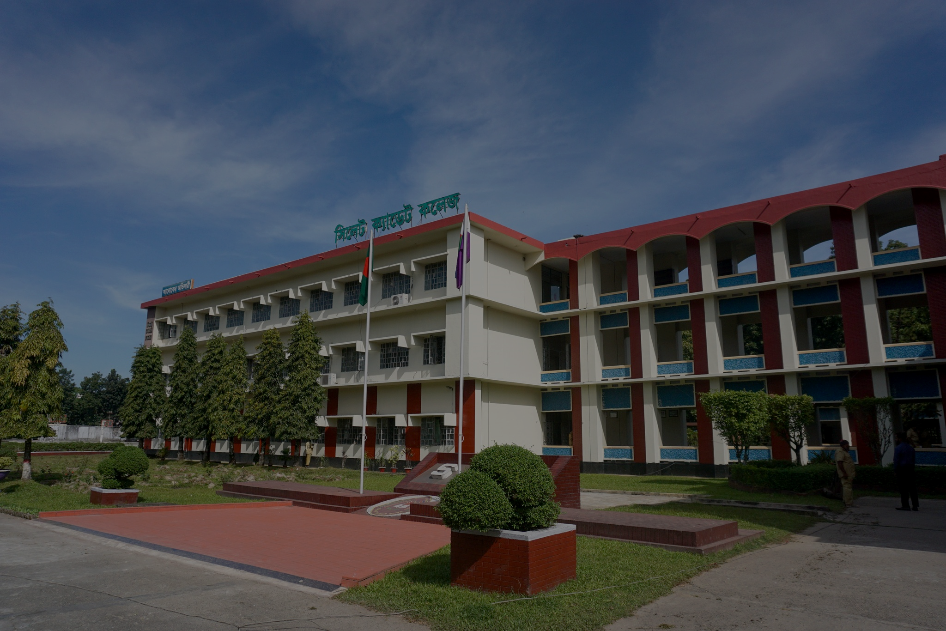
SCHOOL AWARDS
SCHOOL AWARDS
We honor the vital role of teachers and schools in mathematical education through three prestigious awards recognizing their dedication and impact.
IYMC School Award for Most Participants
IYMC School Award for Most Finalists
IYMC School Award for Excellence

Slide 54
SCHOOL AWARDS
SCHOOL AWARDS
We honor the vital role of teachers and schools in mathematical education through three prestigious awards recognizing their dedication and impact.
IYMC School Award for Most Participants
IYMC School Award for Most Finalists
IYMC School Award for Excellence

Slide 55
ACHIEVEMENTS & ACCOMPLISHMENTS

Slide 56
PROGRESSION TIERS

Slide 57
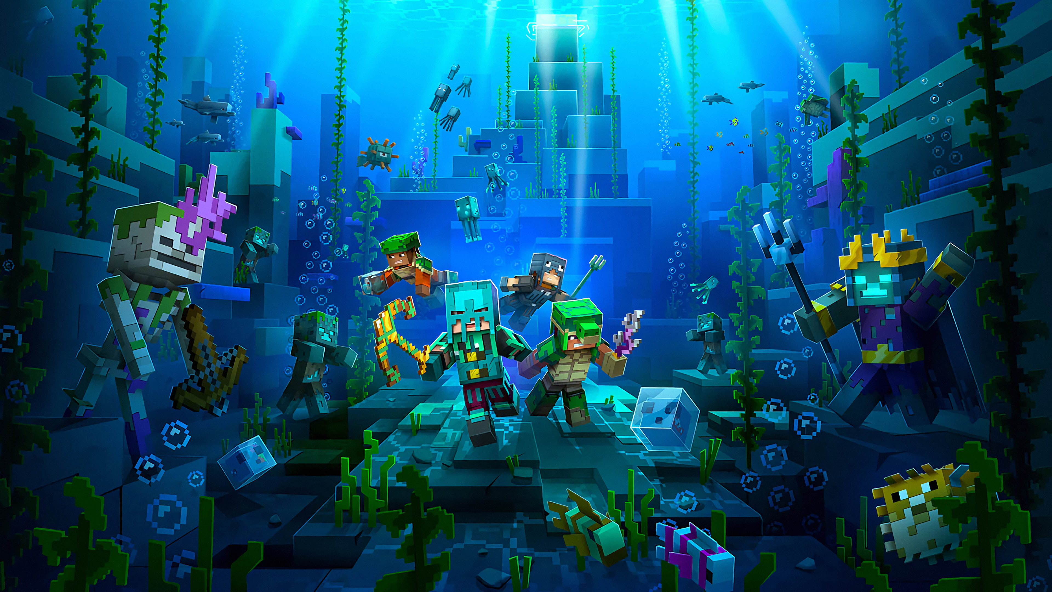
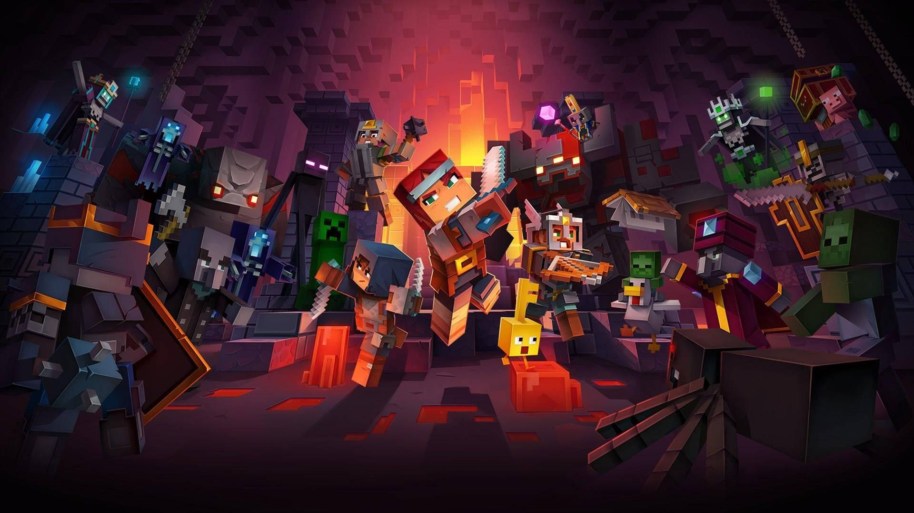
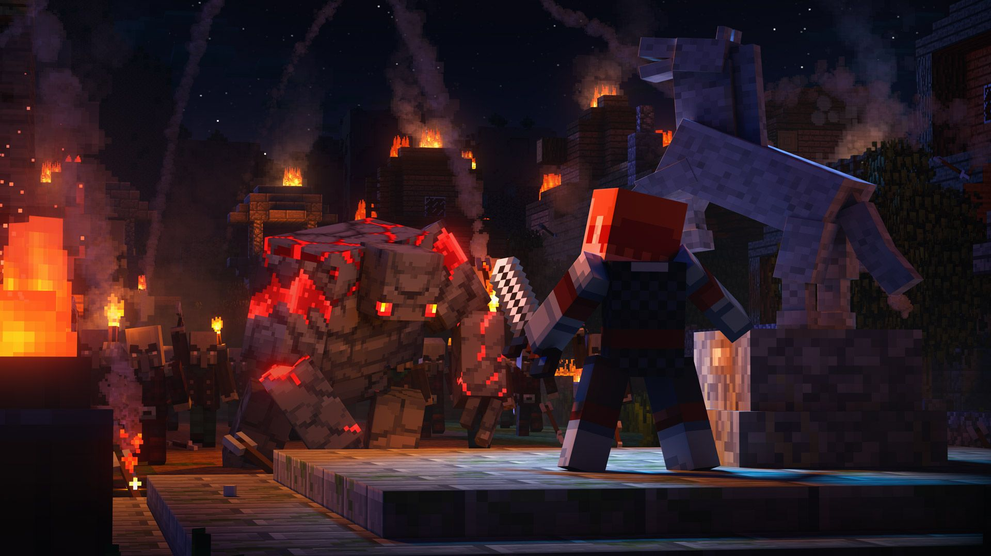
QUALIFICATION ROUND
PRE-FINAL
ROUND
FINAL
ROUND

Slide 58
QUALIFICATION ROUND
PRE-FINAL
ROUND
FINAL
ROUND

Slide 59
Rules:
Access the problems on the official IYMC website.
Beat the clock and submit your answers before the deadline
Your file can be either typed digitally (recommended) or a clear picture of your handwritten work. If you have multiple pictures, merge them into a single file to make your submission complete!
Quest Overview
Your math journey begins with the Qualification Round, the first stage of your quest to become a math champion! You must solve five math challenges labeled A, B, C, D, and E. Each problem will test your mind and skills, with topics ranging from geometry to number theory.
Rules:
Access the problems on the official IYMC website.
Beat the clock and submit your answers before the deadline
Your file can be either typed digitally (recommended) or a clear picture of your handwritten work. If you have multiple pictures, merge them into a single file to make your submission complete!

Slide 60
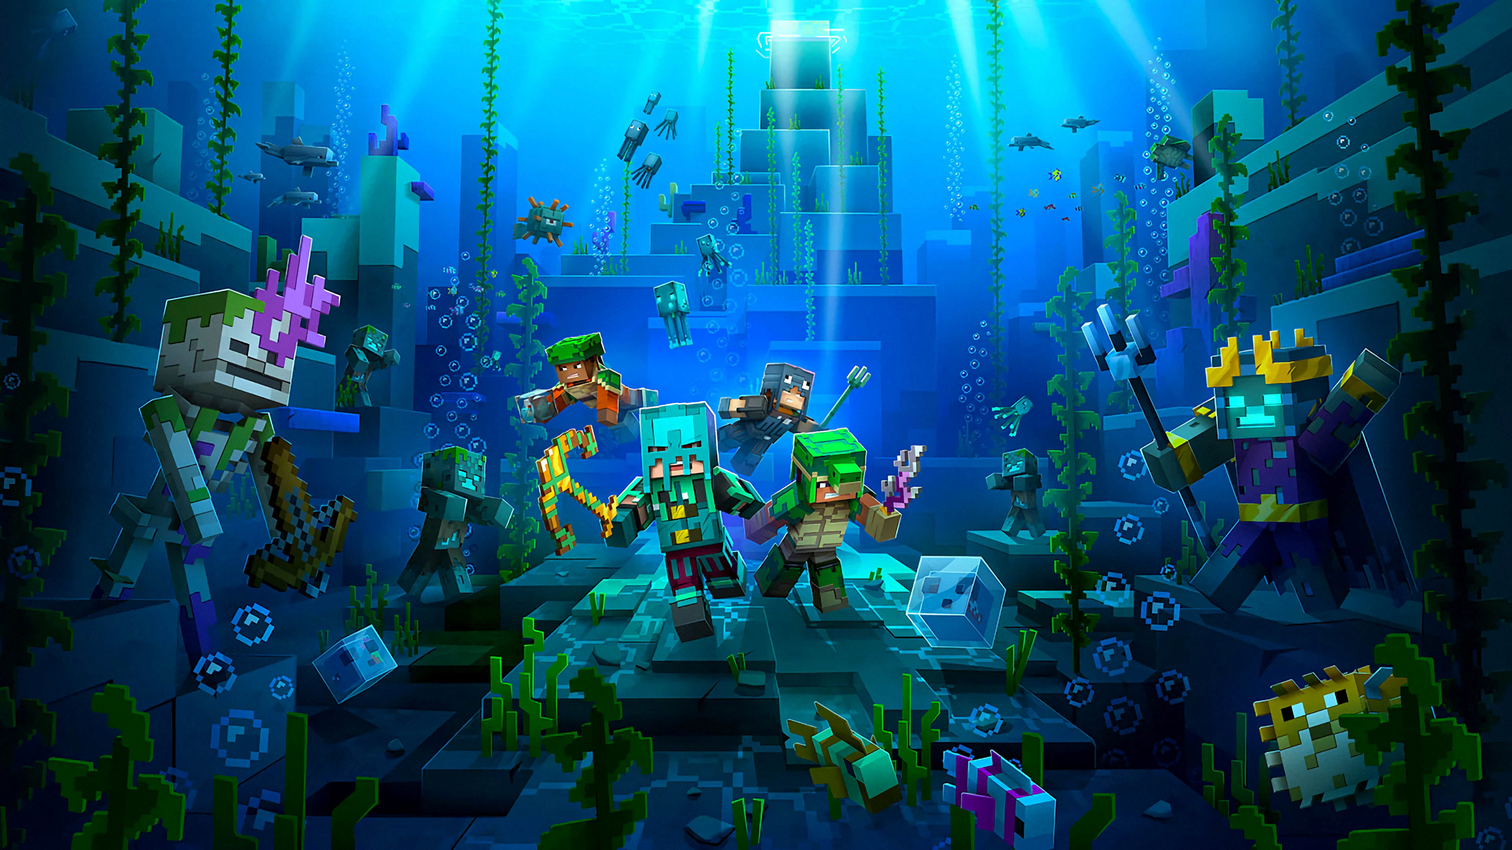
Quest Overview
Your math journey begins with the Qualification Round, the first stage of your quest to become a math champion! You must solve five math challenges labeled A, B, C, D, and E. Each problem will test your mind and skills, with topics ranging from geometry to number theory.
Rules:
Access the problems on the official IYMC website.
Beat the clock and submit your answers before the deadline
Your file can be either typed digitally (recommended) or a clear picture of your handwritten work. If you have multiple pictures, merge them into a single file to make your submission complete!

Slide 61
Quest Overview
Your math journey begins with the Qualification Round, the first stage of your quest to become a math champion! You must solve five math challenges labeled A, B, C, D, and E. Each problem will test your mind and skills, with topics ranging from geometry to number theory.
Rules:
Access the problems on the official IYMC website.
Beat the clock and submit your answers before the deadline
Your file can be either typed digitally (recommended) or a clear picture of your handwritten work. If you have multiple pictures, merge them into a single file to make your submission complete!
submission deadline
16 December 2024 05:59
Result
23 December 2024

Slide 62
Rules:
Access the problems on the official IYMC website.
Beat the clock and submit your answers before the deadline
Your file can be either typed digitally (recommended) or a clear picture of your handwritten work. If you have multiple pictures, merge them into a single file to make your submission complete!
Quest Overview
Your math journey begins with the Qualification Round, the first stage of your quest to become a math champion! You must solve five math challenges labeled A, B, C, D, and E. Each problem will test your mind and skills, with topics ranging from geometry to number theory.
submission deadline
16 December 2024 05:59
Result
23 December 2024

Slide 63
QUALIFICATION ROUND
PRE-FINAL
ROUND
FINAL
ROUND

Slide 64
QUALIFICATION ROUND
PRE-FINAL
ROUND
FINAL
ROUND

Slide 65
Quest Overview
For this level, to advance to the Final Round, you need to reach:
18 points (if you're under 18 years old)
24 points (if you're over 18 years old)
You can score up to 36 points in total.
QUALIFICATION ROUND
PRE-FINAL
ROUND
FINAL
ROUND

Slide 66
Suppose, there is 20 lockers in a hall room. And there are 20 students.
01
02
03
04
05
06
07
08
09
10
11
12
13
14
15
16
17
18
19
20

Slide 67
1st student opened all the lockers
2nd student closed the locker numbered 2,4,6,8…

Slide 68
3rd student opens the lockers 3, 6, 9, 12… numbered
4th student closes the lockers 4, 8, 12, 16… numbered.
https://1drv.ms/p/s!AupDTulzvo3RgRrHk1r2EPmM9qX_
In this way, the students opens the lockers if it is closed and vice versa that are numbered by the multiples of the corresponding student number.

Slide 69
All the students continue in this way.
Now the question is, which numbered lockers will remain opened?

Slide 70
Quest Overview
For this level, to advance to the Final Round, you need to reach:
18 points (if you're under 18 years old)
24 points (if you're over 18 years old)
You can score up to 36 points in total.
QUALIFICATION ROUND
PRE-FINAL
ROUND
FINAL
ROUND

Slide 71
Quest Overview
For this level, to advance to the Final Round, you need to reach:
18 points (if you're under 18 years old)
24 points (if you're over 18 years old)
You can score up to 36 points in total.
The Quest
2x Basic Puzzles:
4 points each.
2x Advanced Puzzles:
6 points each.
2x Special-Creativity Puzzles:
The ultimate boss battles! There's no single correct answer here—your creativity and strategy could earn you between 0 to 8 points!

Slide 72
Quest Overview
For this level, to advance to the Final Round, you need to reach:
18 points (if you're under 18 years old)
24 points (if you're over 18 years old)
You can score up to 36 points in total.
The Quest
2x Basic Puzzles:
4 points each.
2x Advanced Puzzles:
6 points each.
2x Special-Creativity Puzzles:
The ultimate boss battles! There's no single correct answer here—your creativity and strategy could earn you between 0 to 8 points!
JOIN THE GUILD:
To continue your journey, you need to register for the Pre-Final Round with fee of 8 EUR before Tuesday, January 14, 2025.
RACE AGAINST TIME
Your mission begins on Thursday, January 16, 2025. You’ll have 4 days to conquer these puzzles before the final horn sounds on Sunday, January 19, 2025.

Slide 73
The Quest
2x Basic Puzzles:
4 points each.
2x Advanced Puzzles:
6 points each.
2x Special-Creativity Puzzles:
The ultimate boss battles! There's no single correct answer here—your creativity and strategy could earn you between 0 to 8 points!
Quest Overview
For this level, to advance to the Final Round, you need to reach:
18 points (if you're under 18 years old)
24 points (if you're over 18 years old)
You can score up to 36 points in total.
JOIN THE GUILD:
To continue your journey, you need to register for the Pre-Final Round with fee of 8 EUR before Tuesday, January 14, 2025.
RACE AGAINST TIME
Your mission begins on Thursday, January 16, 2025. You’ll have 4 days to conquer these puzzles before the final horn sounds on Sunday, January 19, 2025.
QUEST START
16 January 2025
submission deadline
19 January 2025
Result
27 January 2025

Slide 74
JOIN THE GUILD:
To continue your journey, you need to register for the Pre-Final Round with fee of 8 EUR before Tuesday, January 14, 2025.
RACE AGAINST TIME
Your mission begins on Thursday, January 16, 2025. You’ll have 4 days to conquer these puzzles before the final horn sounds on Sunday, January 19, 2025.
The Quest
2x Basic Puzzles:
4 points each.
2x Advanced Puzzles:
6 points each.
2x Special-Creativity Puzzles:
The ultimate boss battles! There's no single correct answer here—your creativity and strategy could earn you between 0 to 8 points!
Quest Overview
For this level, to advance to the Final Round, you need to reach:
18 points (if you're under 18 years old)
24 points (if you're over 18 years old)
You can score up to 36 points in total.
QUEST START
16 January 2025
submission deadline
19 January 2025
Result
27 January 2025

Slide 75
QUALIFICATION ROUND
PRE-FINAL
ROUND
FINAL
ROUND

Slide 76
QUALIFICATION ROUND
PRE-FINAL
ROUND
FINAL
ROUND

Slide 77
Quest Overview
x20 multiple choice questions.
1 point each question
60 seconds for each
QUALIFICATION ROUND
PRE-FINAL
ROUND
FINAL
ROUND

Slide 78
Quest Overview
x20 multiple choice questions.
1 point each question
60 seconds for each
TEACHER
SUPERVITION
All finalists have to select a official IYMC teacher who agrees to supervise the final exam to ensure fairness

Slide 79
Quest Overview
x20 multiple choice questions.
1 point each question
60 seconds for each
TEACHER
SUPERVITION
All finalists have to select a official IYMC teacher who agrees to supervise the final exam to ensure fairness
EXAM DATE
11 February 2025
6PM-7PM
Result
17 February 2025

Slide 80
TEACHER
SUPERVITION
Quest Overview
All finalists have to select a official IYMC teacher who agrees to supervise the final exam to ensure fairness
x20 multiple choice questions.
1 point each question
60 seconds for each
EXAM DATE
11 February 2025
6PM-7PM
Result
17 February 2025

Slide 81
QUALIFICATION ROUND
PRE-FINAL
ROUND
FINAL
ROUND

Slide 82
PROGRESSION TIERS

Slide 83

THE JOURNEY ENDS
ANY QUESTIONS ??

Slide 84
ANY QUESTIONS ??

Slide 86




+8801300605674
fahhossain@amb.iymc.info
CONTACT US
Submit Your Answer
www.iymc.info/amb/fahhossain

Slide 87


Slide 88


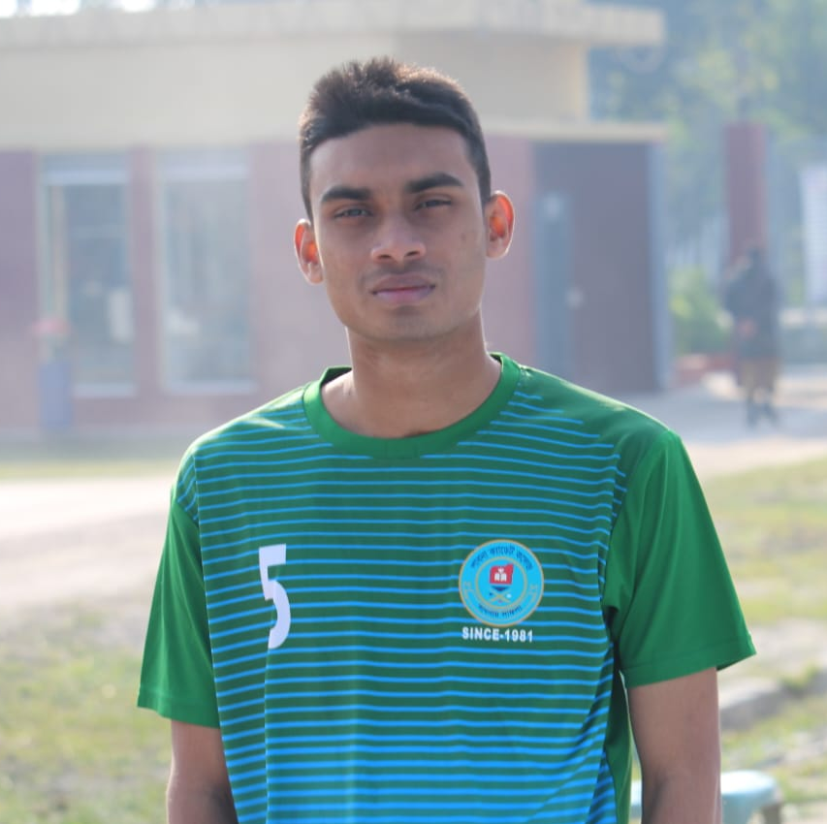
Our Team
Fahim
Siam
Sunnah
Shayikh
sunnah_75
TANVIR SUNNAH
TEAM CO-ORDINATOR
Driven by curiosity and a passion for math, I love experimentation and innovative problem-solving. I am committed to advancing the field while inspiring others through collaboration and inventive solutions.
tanvir-sunnah-594235314
Tanvir Sunnah

